Slide 1


Python for Automation: Strings, Dates, Environments, and Libraries
| DevOps and Cloud Computing

Slide 2

Objective
Perform advanced string handling and date/time operations in Python.
Handle command-line arguments and user input in Python scripts.
Set up and manage virtual environments with venv and pipenv.
Use automation-related libraries like os, sys, subprocess, and shutil for scripting tasks.

Slide 3
Demonstrating common string operations
| DevOps and Cloud Computing

Slide 4
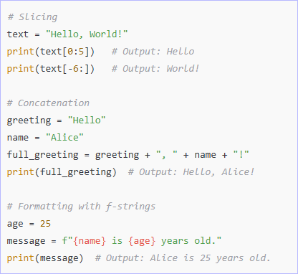
Let’s do it
Here’s a demonstration of common string operations in Python:
1. String Manipulation

Slide 5
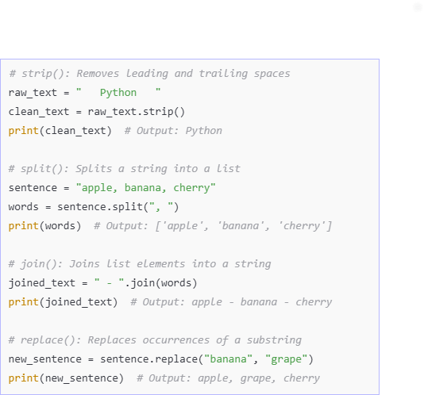
Let’s do it
2. String Methods

Slide 6
Pop Quiz
Q. What is the correct way to format a string using f-strings?
A
B
print(f'Hello'.format(name))
print(f"Hello {name}")

Slide 7
Pop Quiz
Q. What is the correct way to format a string using f-strings?
A
B
print(f'Hello'.format(name))
print(f"Hello {name}")

Slide 8
Introduce Python’s datetime module
| DevOps and Cloud Computing

Slide 9
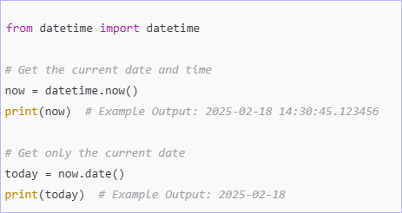
Datetime module
Python's datetime module provides classes for working with dates and times. Below are some common operations:
1. Getting the Current Date and Time

Slide 10
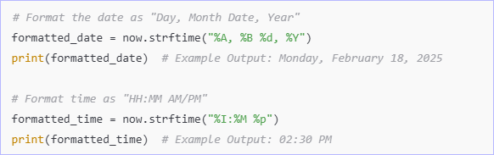
Datetime module
2. Formatting Dates with ‘strftime()’
The ‘strftime()’ method converts a ‘datetime’ object into a formatted string.

Slide 11
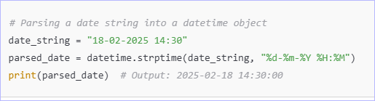
Datetime module
3. Parsing Strings into Dates with ‘strptime()’
The ‘strptime()’ method converts a string into a datetime object.

Slide 12
Pop Quiz
Q. Which function converts a date string into a datetime object?
A
B
datetime.strptime()
datetime.strftime()

Slide 13
Pop Quiz
Q. Which function converts a date string into a datetime object?
A
B
datetime.strptime()
datetime.strftime()

Slide 14
Explaining command-line arguments
| DevOps and Cloud Computing

Slide 15
Command-line arguments
Command-line arguments allow users to pass inputs to a script when running it from the terminal. Python provides multiple ways to handle these arguments.
Using ‘sys.argv’ for Basic Argument Parsing:
The sys module provides sys.argv, a list containing command-line arguments.
sys.argv[0] is the script name.
sys.argv[1:] are the additional arguments.

Slide 16
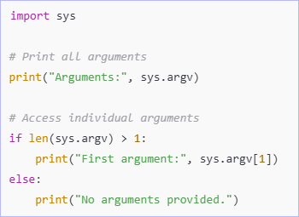
Command-line arguments
Example: Using ‘sys.argv’
Save the following script as ‘script.py’ and run it in the terminal:

Slide 17
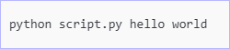
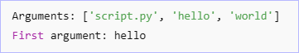
Command-line arguments
Run from the command line:
Output:

Slide 18
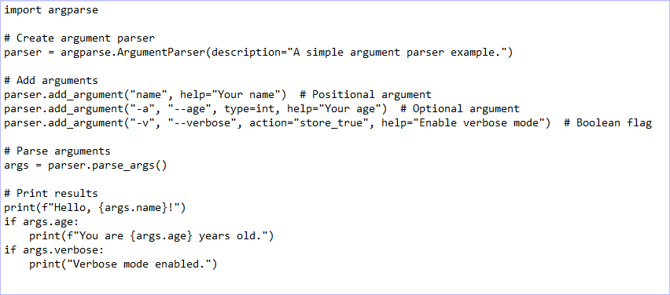
Command-line arguments
2. Using ‘argparse’ for Advanced Argument Parsing
The ‘argparse’ module provides a structured way to handle arguments with validation, types, and help messages.
Example: Using ‘argparse’

Slide 19
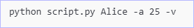
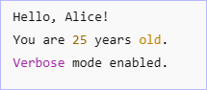
Command-line arguments
Run from the command line:
Output:

Slide 20
Demonstrating capturing user input using input()
| DevOps and Cloud Computing

Slide 21
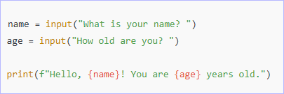
Let’s do it
Here’s a simple example of capturing user input using input() in Python!
Explanation:
input() displays the prompt (like "What is your name?") and waits for the user to enter a value.
The entered value is always treated as a string, so if you need a number, you’ll need to convert it with int() or float().

Slide 22
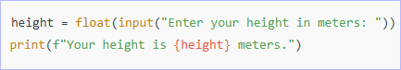
Let’s do it
For example:

Slide 23


Take A 5-Minute Break!
Stretch and relax
Hydrate
Clear your mind
Be back in 5 minutes

Slide 24
The importance of virtual environment for dependency management
| DevOps and Cloud Computing

Slide 25
Importance of virtual environment
Virtual environments are essential for managing dependencies in software development, especially when working with Python or other languages that rely on external packages. Here’s why they are important:
Isolating Dependencies
Reproducibility
Avoiding System-wide Package Modifications
Simplified Dependency Management
Better Collaboration
Easier Deployment

Slide 26
Demonstrating setting up virtual environments
| DevOps and Cloud Computing

Slide 27
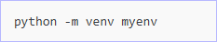
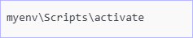
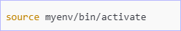
Let’s do it
Using ‘venv’ (Python Built-in)
1. Create a virtual environment:
2. Activate the virtual environment
Windows (cmd/Powershell):
Mac/Linux:

Slide 28
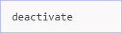
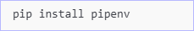
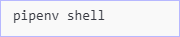
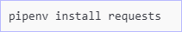
Let’s do it
3. Deactivate the virtual environment:
Using ‘pipenv’ (Advanced Dependency Management)
Install ‘pipenv’ (if not installed):
Create and activate a virtual environment:
Install a package:

Slide 29
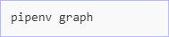
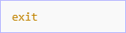
Let’s do it
4. List dependencies:
5. Deactivate the virtual environment:
‘venv’ is simple and lightweight, while ‘pipenv’ provides better dependency tracking and environment management.

Slide 30
Teaching package management basics
| DevOps and Cloud Computing

Slide 31
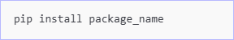
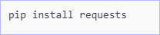
Let’s do it
Package Management Basics with ‘pip’
Install Packages:
Example:

Slide 32
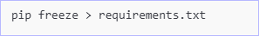
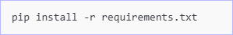
Let’s do it
2. Freeze Dependencies:
Save installed packages and their versions:
3. Install Dependencies from ‘requirements.txt’:

Slide 33
Introducing essential libraries for system automation
| DevOps and Cloud Computing

Slide 34
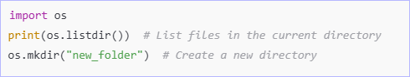
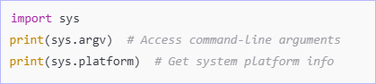
Libraries for system automation
1. ‘os’ – File & Directory Operations
2. ‘sys’ – Command-line Arguments & System Info

Slide 35
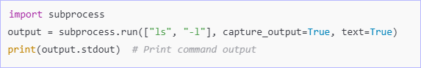
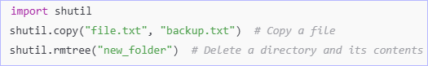
Libraries for system automation
3. ‘subprocess’ – Run Shell Commands
4. ‘shutil’ – High-level File & Directory Management

Slide 36
Demonstrating practical use cases
| DevOps and Cloud Computing

Slide 37
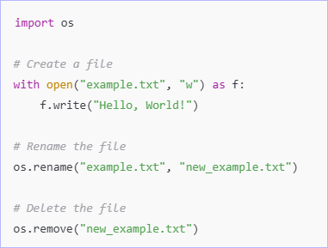
Let’s do it
Practical Use Cases:
1. ‘os’ – Create, Rename, and Delete Files

Slide 38
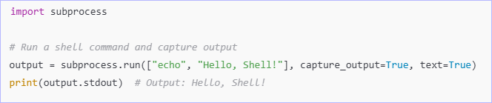
Let’s do it
2. ‘subprocess’ – Run a Shell Command & Capture Output

Slide 39
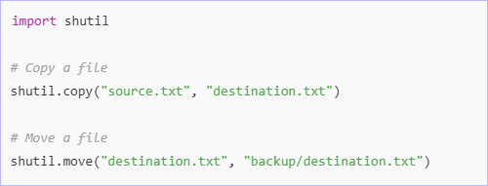
Let’s do it
3. shutil – Copy or Move Files

Slide 40
Time for case study!

Slide 41
Important
Complete the post-class assessment
Complete assignments (if any)
Practice the concepts and techniques taught in this session
Review your lecture notes
Note down questions and queries regarding this session and consult the teaching assistants

Slide 42
Thanks!

